Slide 1
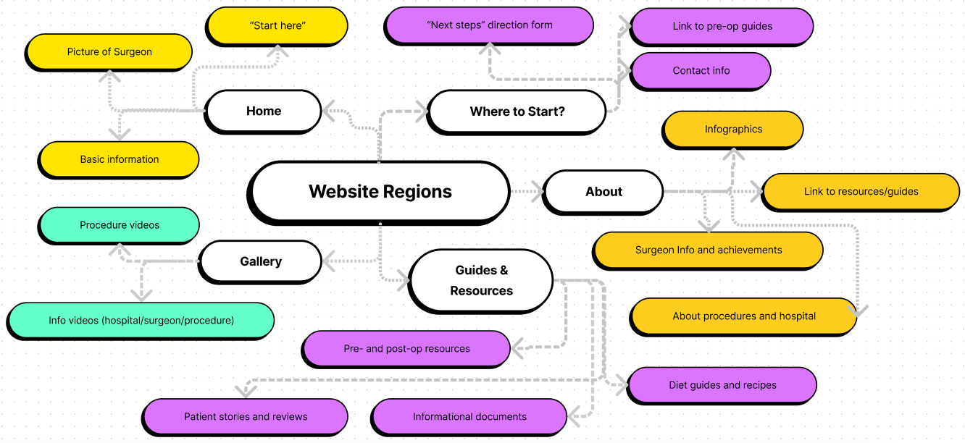



Website idea cloud
Nav bar anatomy
Home
About
Procedures
Our Hospital
Resources
Patient Stories
Landing page
Our Staff
Pre- and post-op resources
Video gallery
Blog
Start Here
Nav bar
Sub nav
Header (basic outlines)
About Resources Start Here
Search bar
Header on scroll (basic outlines)
About Resources Start Here
Click logo in either format to go back to the Home page
Hover over nav options to reveal dropdown
Nav option “greys out” when on a page in that category
In original format, type in search bar to search the website

Slide 2

AdventHealth Celebration
Bariatric Surgery

